Slide 1

Dr. York Mentor Presentation
Ben Koopmann ACS 560

Slide 2
Interview Format
Multiple smaller interviews over 2 weeks
Email chain for clarification
Prior experience with him as a student, TA, and thesis advisor

Slide 3
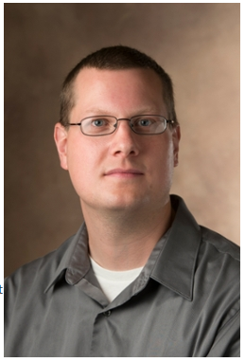
Who is Dr. York
Instructor in the Electrical and Computer Engineering Department
Teaches Microcontrollers and Circuit classes
Worked at SIUE since 2015
Sits on multiple faculty search and scholarship committees
Bacholers/Masters SIUE 2002 2007 Ph.D 2015 Washington University

Slide 4
Dr. York’s Teaching Overview
Favorite course is Microcontrollers
Prefers hands on courses versus traditional bookwork style
Circuit classes are somewhat traditional bookwork style
Biggest challenge in teaching is keeping students engaged especially with dry material

Slide 5
Dr. York’s Teaching Overview
Biggest obstacle in past few years has been covid
Took away from personal interactions with students
Hard to teach STEM lab based courses without material and equipment
Parts shortages have made class more difficult to teach
Uses experimental learning to help students learn

Slide 6
Research
SIU School of Medicine imaging system for thoracic surgery
Camera for between ribs and keep track of surgeon’s tools
Ph.D project: tool for measuring tendon strength using image sensors
Could go into more detail on project, but gets complicated very quickly
Prior work with US Air Force on sensitive projects

